Slide 1


Cloud based
integrated
development
environment
Sahil Suhas Sadekar
Guide- MRS. A. A. JAMGAONKAR
Seminar
PES Modern College of Engineering
Department of Computer Engineering
Savitribai Phule Pune University
dd-October-2024
01

Slide 2
outline:
1 Introduction
2 Literature survey
3 Objectives and Scope
4 Problem Statement
5 Architectural Diagram
6 Algorithmic Approach
7 Input / Data sets
8 Results/Experimental Work
9 Conclusion / Summary
10 References

Slide 3
introduction:
As software development evolves, the demand for flexible, scalable, and high-performing development environments is greater than ever. Cloud-Based Integrated Development Environments (IDEs) provide developers with remote access to powerful tools, removing the limitations of local hardware and enhancing collaboration.
However, managing cloud resources efficiently remains a challenge. This is where Machine Learning (ML) comes in. By integrating advanced ML algorithms, especially reinforcement learning, cloud IDEs can intelligently allocate resources based on real-time usage patterns. This ensures that developers have the resources they need, exactly when they need them, optimizing performance while minimizing costs.
02

Slide 4
litearature survey:
Early Research (2012): Focused on resource constraints and collaboration in distributed teams (Buse and Zimmermann).
Architecture Design (2018): Explored cloud resource allocation and IDEs using virtualized environments (IEEE Access).
Scalability (2019): Shift towards containerization (Docker) for productivity and scalability (IEEE Transactions on Cloud Computing).
Advanced Container Management (2020): Kubernetes automates container management, enabling auto-scaling and improved performance (IEEE Cloud Computing).

Slide 5
litearature survey:
Research Gaps:
Container Security: Shared kernel architecture in Docker poses security risks (IEEE Access, 2020).
Machine Learning Integration in Cloud IDEs:
Intelligent Resource Allocation: ML models like SVMs, Decision Trees, and Neural Networks predict resource usage for efficient allocation (IEEE Transactions on Cloud Computing, 2021).
Application to Cloud IDEs: ML algorithms optimize resource allocation for cost-efficiency and performance in multi-tenant cloud IDEs (IEEE Access, 2020).
Reinforcement Learning (RL) for Smart Resource Allocation and Auto-scaling:
RL-based Auto-Scaling: RL methods, such as Q-learning and policy-gradient methods, enable dynamic, real-time resource management, outperforming traditional approaches (IEEE Access, 2019).

Slide 6
litearature survey:
Reference | Objective Parameters | Evaluation Tool | Advantages | Limitations | Dataset Used
Ghobaei et al. [23] | CPU utilization,Response time | CloudSim | Decreased cost,Improves utilization resource | Limited to SaaS only | Clarknet and NASA
ushar et al. [25] | Response Time, Finishing time, AverageVM load, Rejection percentage [7] | CloudSim | Effective Resource utilization, Proactive approach [7] | Finite number of sources for scaling re- | Clarknet
Xu et al. [33] | CPU utilization, Resource usage Cost and SLA con- straint | Apache Hadoop (YARN) | Reduction in resource cost through optimization, SLA confirmation | Limited workload narios sce- | Testbed
Agarwal et al. [27] | Request arrival rate,SLA | Kubernetes | Reduced cold-start overhead | Efficiency of the training model | Azure traces ( HTTP ) Rossi et al. [35] CPU utilization,

Slide 7
objectives:
To analyze the current landscape of cloud-based IDEs and their features.
01
To identify the challenges faced by developers in adopting cloud-based IDEs
02
To propose solutions that improve the performance, security, and usability of cloud-based IDEs.
03
Optimize Resource Allocation Using Machine Learning: Implement ML algorithms (such as reinforcement learning) to dynamically allocate cloud resources based on real-time user demand, ensuring efficient use of computing power and reducing idle resources.
04
05

Slide 8
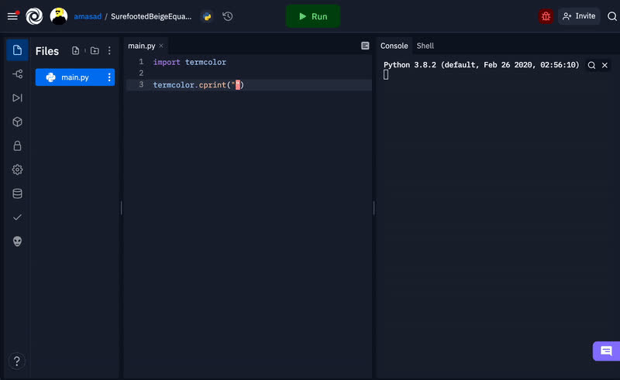
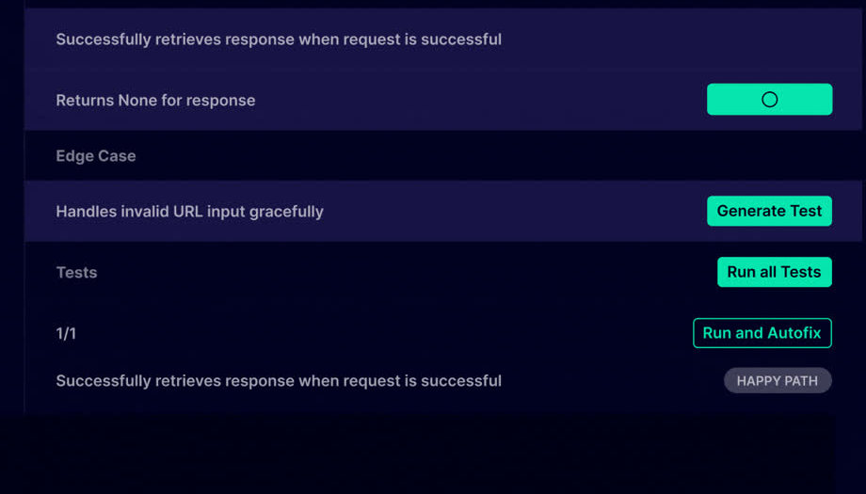
Popular Cloud IDEs and Their Resource Allocation Limitations (1):
Replit
Codium
Resource Allocation Techniques:
Static Allocation: Fixed resources assigned regardless of demand.
Dynamic Allocation: Resources adjusted based on current needs.
Auto-scaling: Automatically increasing or decreasing resources based on load.
Limitations:
Each method has trade-offs in terms of cost, performance, and complexity.

Slide 9
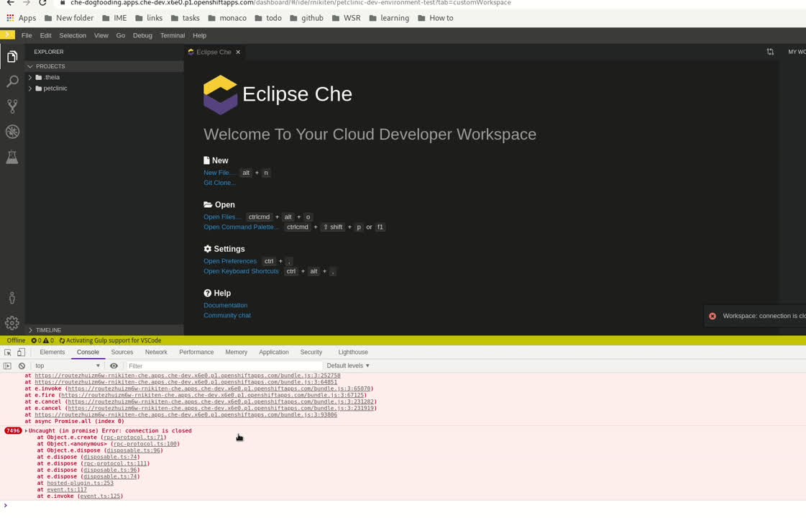
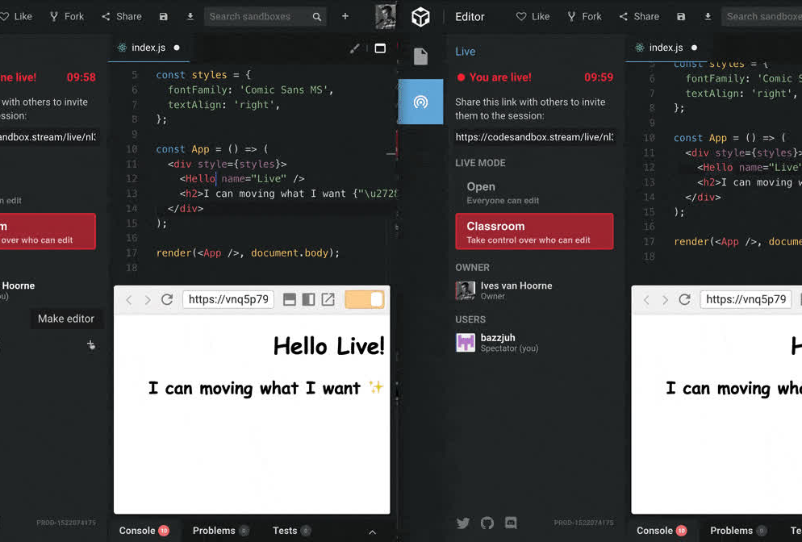
Popular Cloud IDEs and Their Resource Allocation Limitations (2):
Eclipse
CodeSandBox
Eclipse Che
Description: A Kubernetes-native cloud IDE for enterprise development.
CodeSandbox:
Description: Web-based IDE for quick prototyping and collaboration.

Slide 10


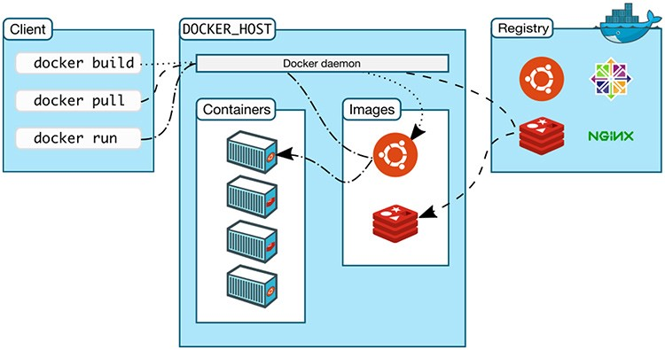
Architectural Diagram 1:
1. Containerization for Isolation:
Docker containers ensure each user’s development environment is isolated, avoiding conflicts between dependencies or resources.
Users have their own sandboxed workspace, enhancing security and preventing interference between environments.
2. Decentralized Container Management:
Each user’s development environment is encapsulated in its dedicated container, creating a scalable and decentralized approach.
Containers can be distributed across multiple nodes, improving resource distribution and fault tolerance.

Slide 11
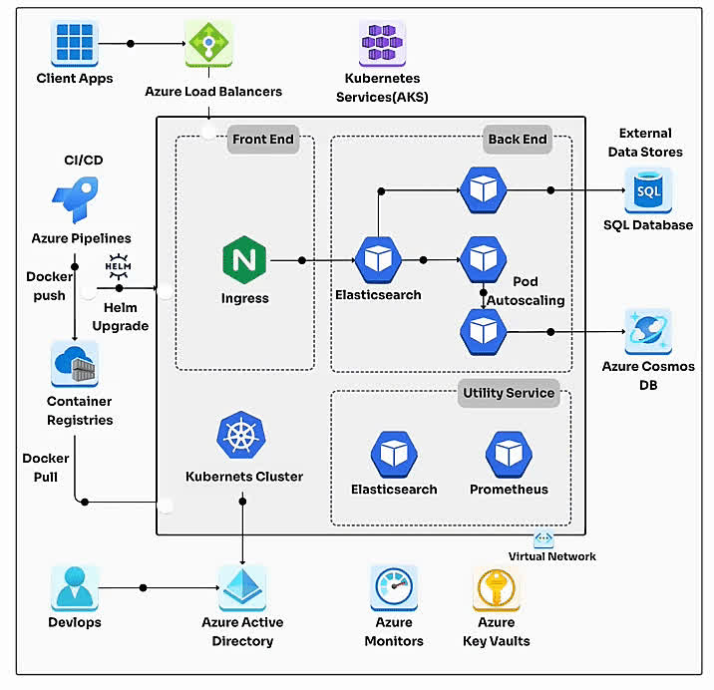
Architectural Diagram 2:
Kubernetes: Orchestrates containerized workloads, enabling scaling and management of IDE instances.
Docker: Provides isolated, consistent development environments via containers.
Ingress Controller: Routes traffic to appropriate services, ensuring secure external access.
Azure Cloud: Powers compute, storage, and networking with integrated services like Azure Kubernetes Service (AKS).
Persistent Storage: Stores user data and project files using cloud-backed volumes.
Auto-scaling: Adjusts resources dynamically based on real-time user demand.
Security: Role-based access and OAuth for secure user authentication.
06

Slide 12
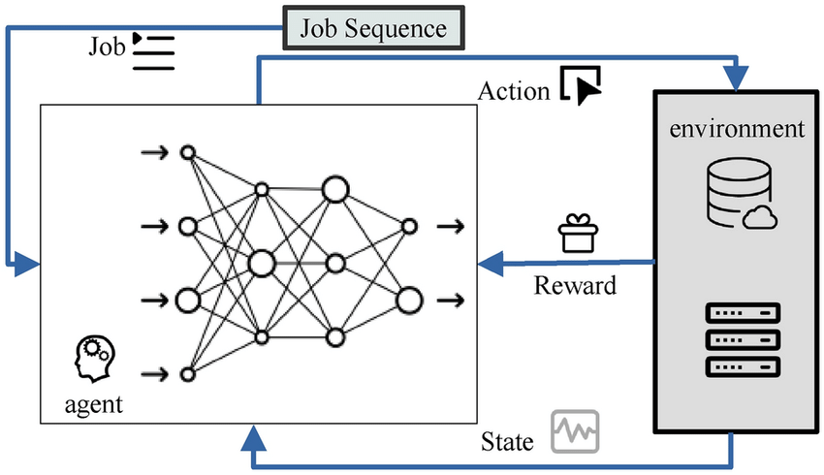
Algorithmic Approach (1/2):
Cost-aware job scheduling for cloud inutances using deep reinforcement learning:
Objective: Minimize cloud costs while meeting job deadlines.
Deep Reinforcement Learning (DRL): Learns optimal scheduling policies by balancing cost and performance.
Action: Allocate cloud resources (VMs/containers) based on current job and workload demand.
State: Includes job queue, resource availability, and cloud pricing.
Reward Function: Penalizes high costs and missed deadlines, rewards efficient resource use.
Cost Models: Considers on-demand, reserved, and spot instances pricing.
Dynamic Scaling: Adapts resource allocation in real-time as job workloads change.
Key Benefit: Reduces cloud expenses while maintaining job performance.

Slide 13
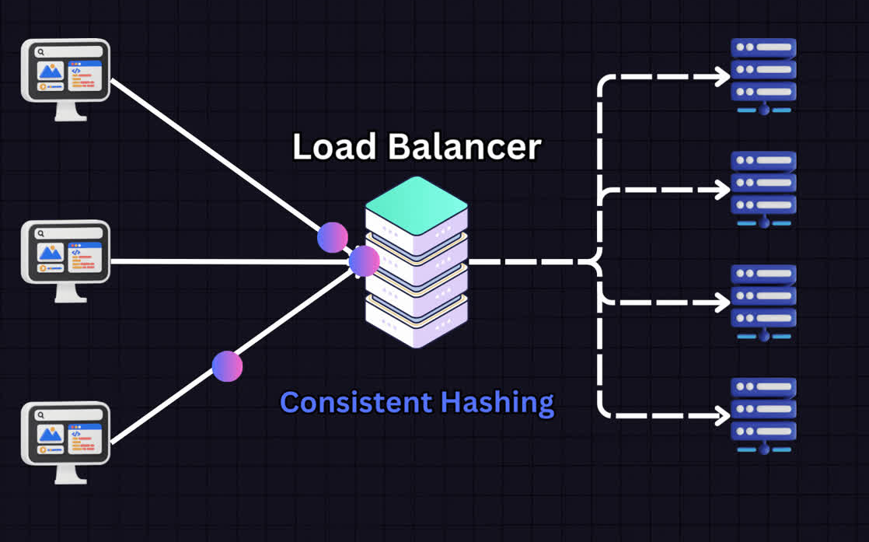
Algorithmic Approach (2/2):
Load Balancing Algorithm for Cloud Containers:
Objective: Minimize cloud costs while meeting job deadlines.
Deep Reinforcement Learning (DRL): Learns optimal scheduling policies by balancing cost and performance.
Action: Allocate cloud resources (VMs/containers) based on current job and workload demand.
State: Includes job queue, resource availability, and cloud pricing.
Reward Function: Penalizes high costs and missed deadlines, rewards efficient resource use.
Cost Models: Considers on-demand, reserved, and spot instances pricing.
Dynamic Scaling: Adapts resource allocation in real-time as job workloads change.
Key Benefit: Reduces cloud expenses while maintaining job performance.

Slide 14
Input / Dataset:
The dataset is downloaded from the UCI Machine Learning Repository:
http://kdd.ics.uci.edu/databases/shuttle/shuttle.data.html.
The data is in a space-delimited ASCII format.
For example, 2,0,0,0,0,0,1 where:
2 → Class number (indicating shuttle status),
0,0,0,0,0 → Feature values representing sensor data,
1 → Classification label (e.g., stable or unstable shuttle status).
This dataset is useful for real-time system monitoring or predictive maintenance tasks.

Slide 15
conclusion:
In conclusion, this seminar report has explored the concept of Cloud-Based Integrated Develop ment Environments (IDEs) and their transformative impact on software development practices. The shift from traditional local environments to cloud-based solutions has significantly enhanced **collab oration**, **accessibility**, and **scalability**, addressing many challenges faced by developers in today’s fast-paced digital landscape. We examined various cloud IDEs, analyzing their features, strengths, and weaknesses. The inte gration of cloud computing with development tools has facilitated **real-time collaboration** among teams, allowing developers to work together seamlessly, regardless of geographical constraints. This has proven particularly beneficial in fostering **innovation** and **efficiency** in software develop ment processes. Moreover, the report has outlined the potential challenges associated with cloud-based IDEs, such as **security concerns**, **dependency on internet connectivity**, and **limitations in resource intensive applications**. However, the advantages, including **reduced setup time**, **cost-effectiveness**, and the ability to leverage powerful cloud resources, often outweigh these challenges.

Slide 16
References:
[1] B. Smith, “The Future of Development: Cloud-Based Integrated Development Environments,” Journal of Software Engineering, vol. 45, no. 3, pp. 200-215, 2023.
[2] R. Johnson and M. Patel, “A Comprehensive Survey on Cloud IDEs: Trends and Challenges,” Proceedings of the International Conference on Software Development, London, UK, July 2023, pp. 45-52.
[3] A. Lee, “Cloud Computing and the Development Lifecycle: An In-Depth Analysis,” IEEE Transactions on Cloud Computing, vol. 10, no. 1, pp. 50-62, 2024.
[4] P. Gupta and L. K. Zhang, “Collaborative Software Development in the Cloud: A Study of Cloud IDEs,” International Journal of Computer Applications, vol. 175, no. 8, pp. 18-25, 2024.
[5] J. Doe, “Challenges in Cloud-Based Development: Security and Accessibility,” ACM Computing Surveys, vol. 56, no. 4, Article 78, 2023.

Slide 17


